Slide 1
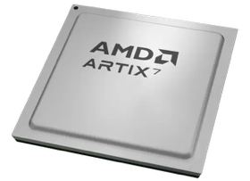
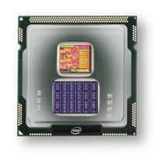
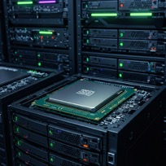
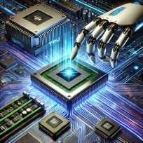
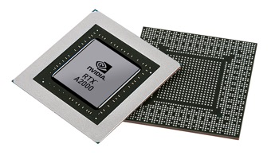


Christof Teuscher
ECE 410/510: Hardware for AI and ML
Welcome and Introduction
Portland State University
Department of Electrical and Computer Engineering (ECE)
www.teuscher-lab.com
teuscher@pdx.edu

Slide 2
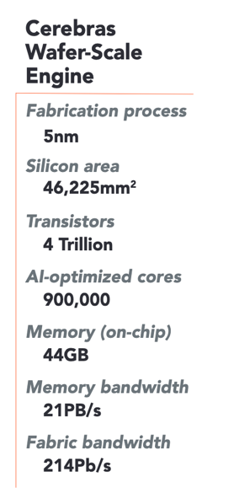
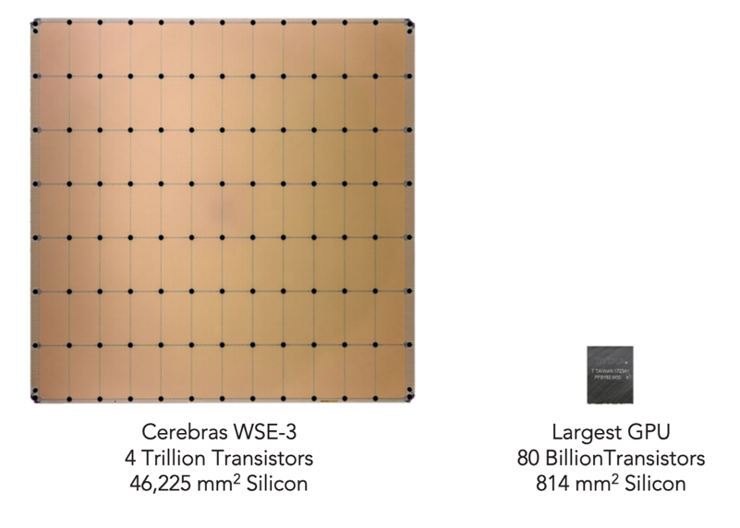


Electronic chips: the most complex human-made systems ever created
The human brain consists of 100 billion neurons and over 100 trillion synaptic connections.

Slide 3


Slide 4
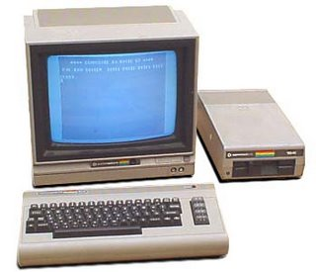

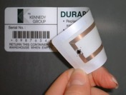
Commodore C64
Radio-frequency identification (RFID) tag
1982
Same amount of memory!
Notes:
4

Slide 5
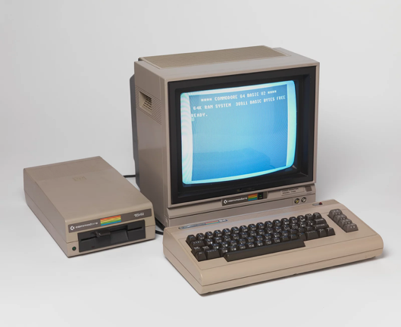
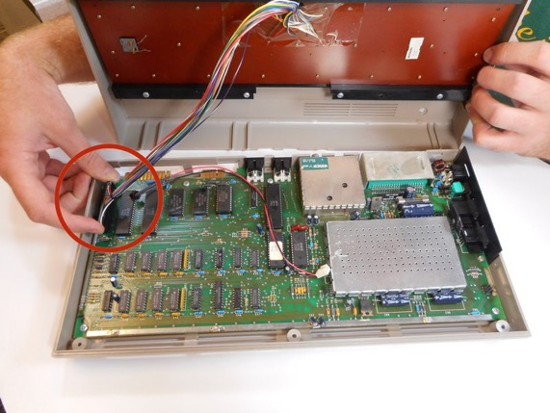
The way we build, program, and use computers has
fundamentally changed
MOS 6510, 1 MHz, 64 kB RAM, ~9000 transistors

Slide 6

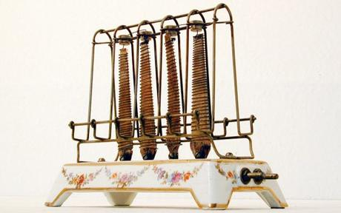
Notes:
6

Slide 7

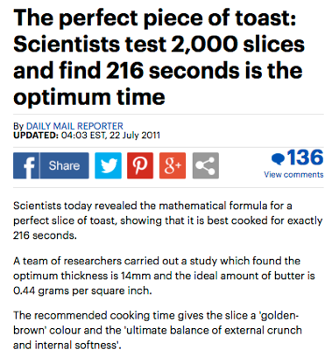
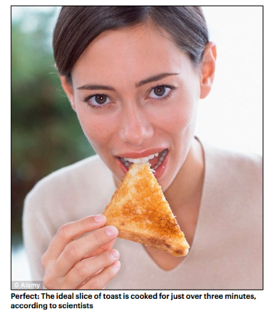
Notes:
7

Slide 8
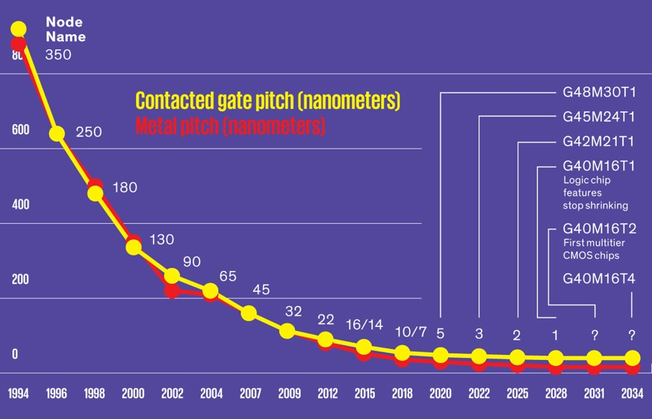
Smaller smaller smaller smaller smaller smaller smaller smaller smaller
Miniaturization: the cornerstone of progress in computer science
Feature size of transistors [nm]
1000x smaller than a hair
10,000x smaller than a hair
IEEE Spectrum
Notes:
8

Slide 9
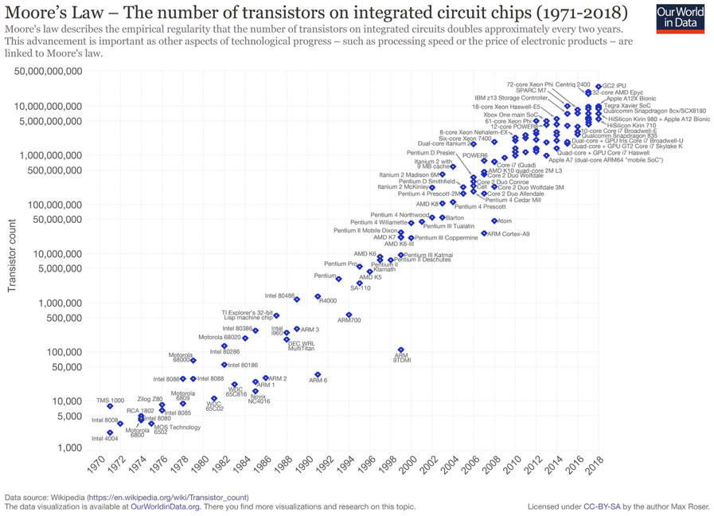

Slide 10

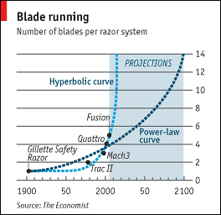

The Cutting Edge: A Moore's Law for Razor Blades?
Source: The Economist, March 16, 2006
Notes:
10

Slide 11
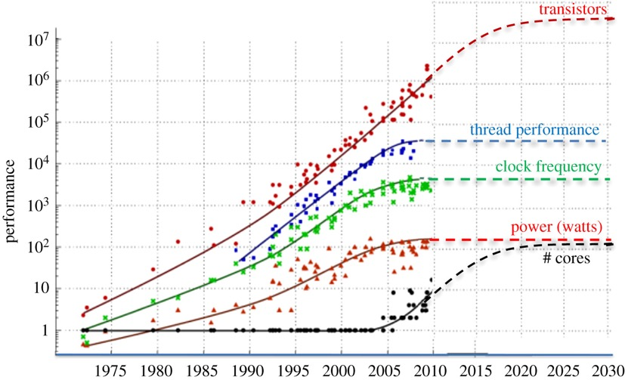
https://royalsocietypublishing.org/doi/10.1098/rsta.2019.0061

Slide 12
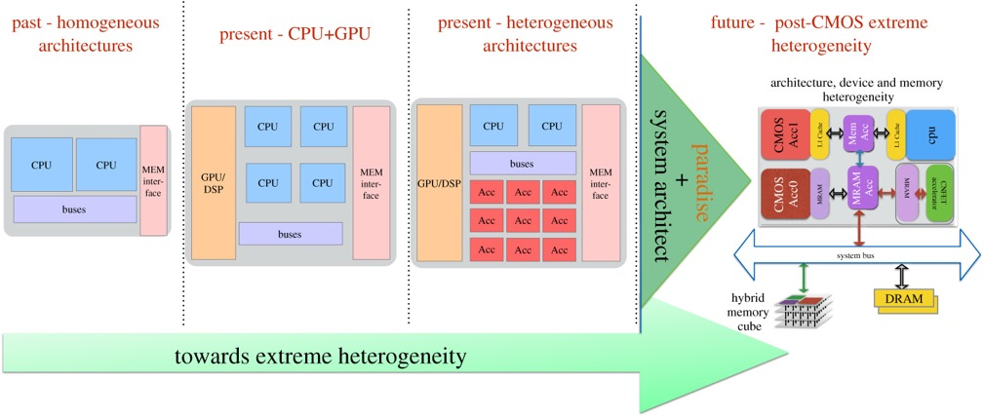
https://royalsocietypublishing.org/doi/10.1098/rsta.2019.0061

Slide 13
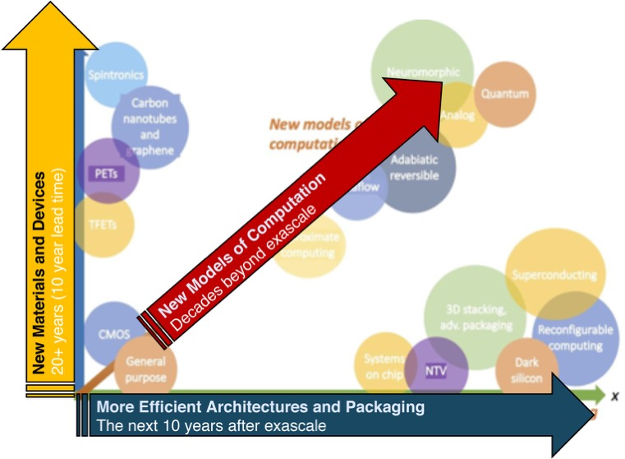
https://royalsocietypublishing.org/doi/10.1098/rsta.2019.0061

Slide 14
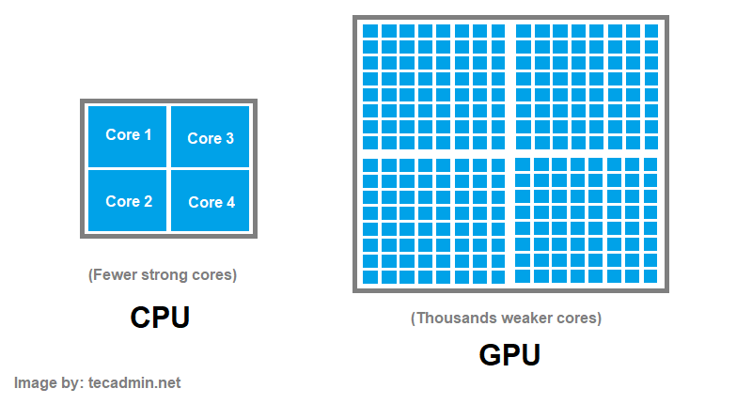
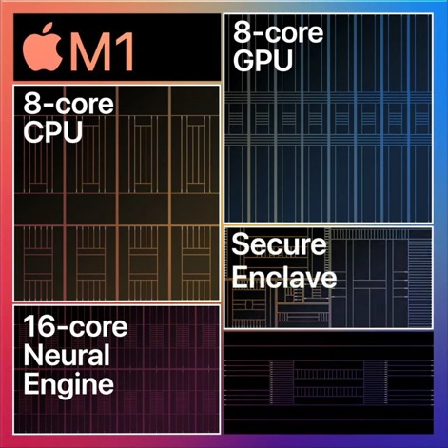

Slide 15
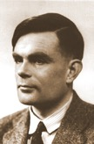

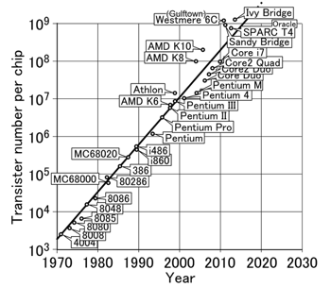

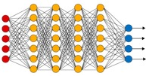
How did we get here?
Alan Turing
Deep neural networks
Transformers
Models that learn and adapt from data
(Big) data
Moore’s law

Slide 16
Where is this going?
50ies
90ies
Today
The future…
…disappearing AI
ChatGPT
ANN
Traditional AI
Just the very
beginning…
Massive progress with new models and new data

Slide 17
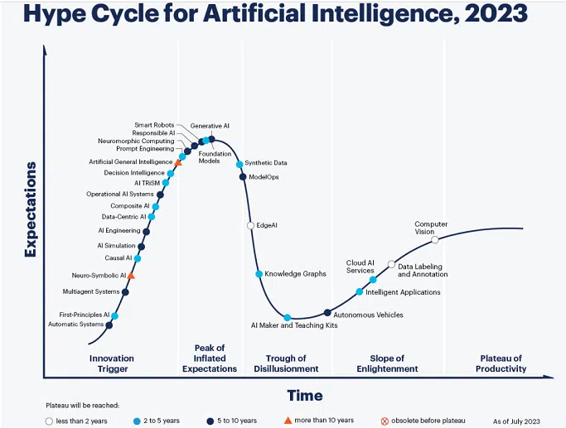
AI is no longer hype—it’s transforming how we work, innovate, and invest.
How does AI as a revolutionary technology compare to the steam engine, telegraph, photograph, telephone, automobile, airplane, radio, television, computer, the internet, mobile phone, and the personal computer?

Slide 18
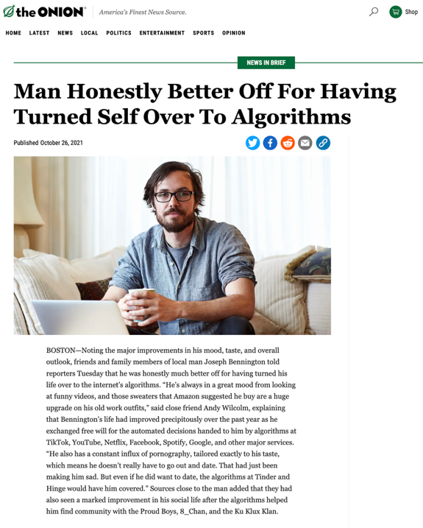

Slide 19
Traditional computer engineering
and architecture is dead

Slide 20
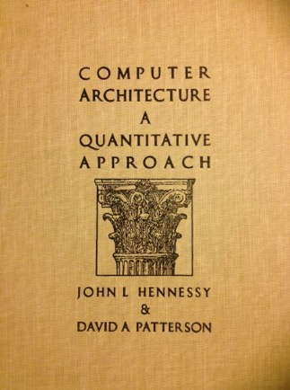
AI/ML moves fast
“In AI, something breaks, ships, or goes viral every six hours.”
Timescale: ~weeks
For comparison: Hennessy & Patterson, first edition, 1990
I have a beautiful 2nd edition from 1996 that I bought for my computer architecture class.

Slide 21
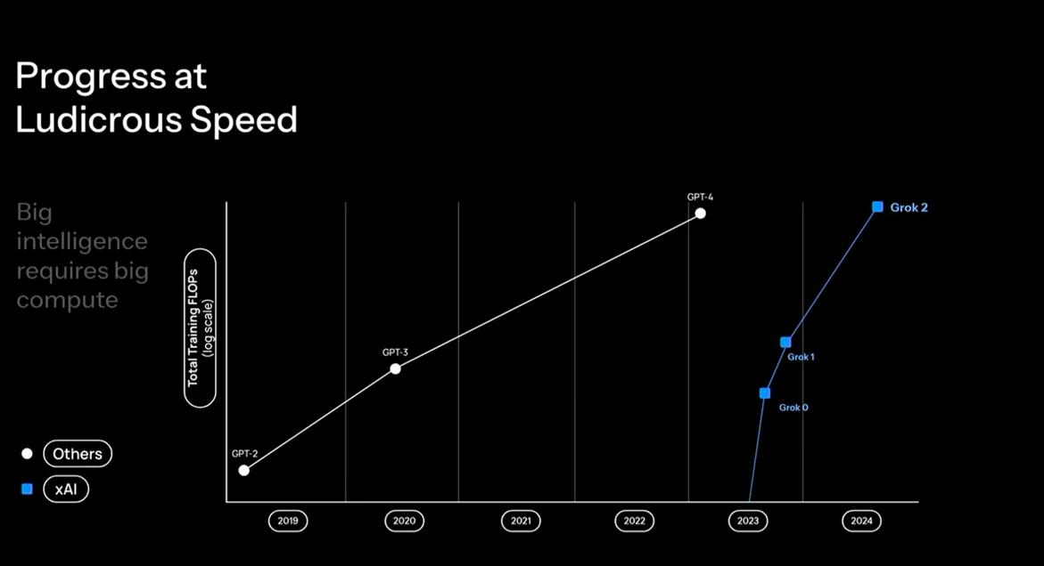

Slide 22
What challenges do computer engineers face?
Deal with unseen complexities (server-scale AI machines, chiplets, trillions of transistors,…)
Application-specific architectures for entirely new workloads
Power barriers
Shorter time to market
Drastically increased need to keep up with state-of-the-art technological developments across the entire compute stack.
Ethical issues
…

Slide 23
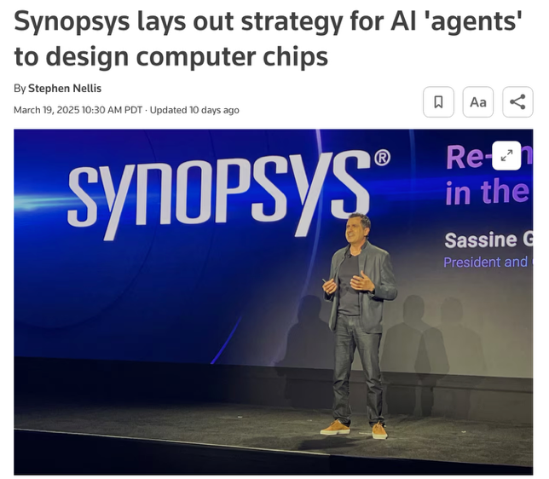
“[…] shift from designing single chips to AI server systems with hundreds or even thousands of chips in them while aiming to release a new server each year”
"These are very complex and difficult to design," Ghazi said of new AI computers. "The pressure engineers are feeling today is not only complexity, it is complexity and the pace by when they need to deliver these products, as well as the cost."
AgentEngineer: an "agent" that a human engineer can give instructions to.
https://www.reuters.com/technology/artificial-intelligence/synopsys-lays-out-strategy-ai-agents-design-computer-chips-2025-03-19/

Slide 24
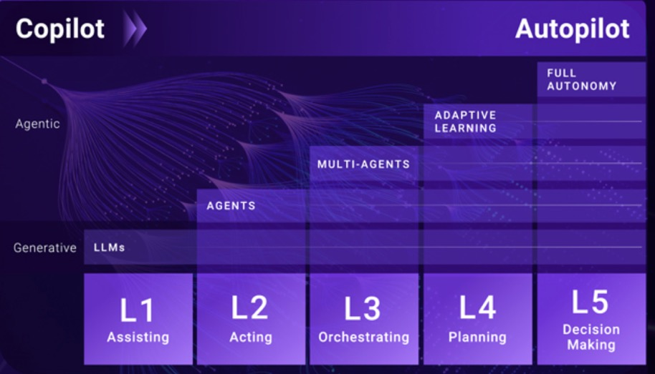
Evolution from generative to agentic AI. Source: Synopsys/SNUG
https://semiengineering.com/first-time-silicon-success-plummets

Slide 25
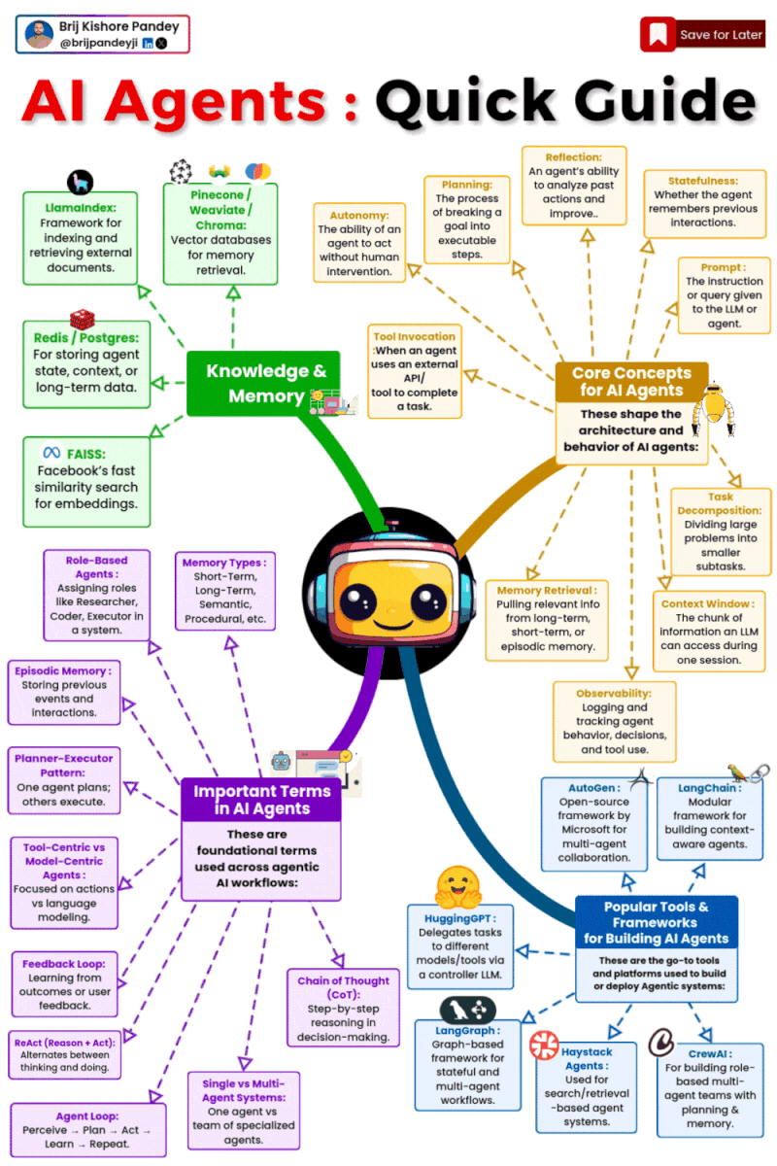
From LLMs to
Agentic Systems

Slide 26
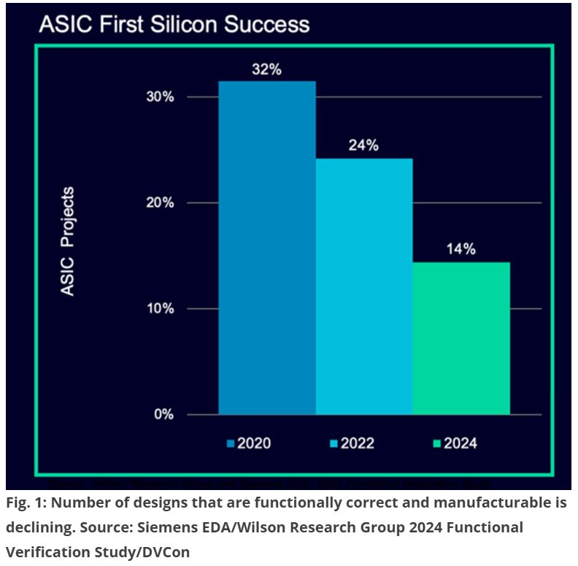
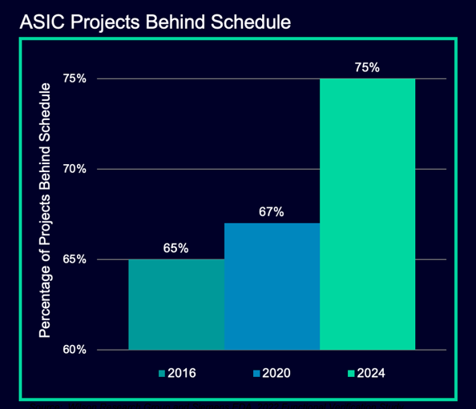
https://semiengineering.com/first-time-silicon-success-plummets

Slide 27

https://www.nytimes.com/2025/03/14/technology/why-im-feeling-the-agi.html

Slide 28

https://www.bbc.com/news/articles/c0kgydkr516o

Slide 29

LLMs prevent you from thinking and writing.
You can’t just learn how to craft a prompt for an A.I. chatbot without first having the experience, exposure and, yes, education to know what the heck you are doing.
Learning is a messy, nonlinear human development process that resists efficiency. A.I. cannot replace it.
https://www.nytimes.com/2025/03/29/opinion/ai-tech-innovation.html

Slide 30
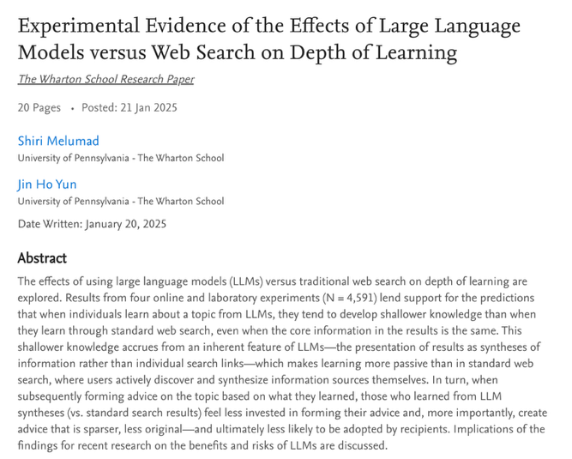
Using LLMs leads to developing shallower knowledge compared to standard web search.
”Processed" knowledge delivered to the learner, even if perfectly summarized, will often lead to shallower learning.
Active learning is the best learning.
https://papers.ssrn.com/sol3/papers.cfm?abstract_id=5104064

Slide 31
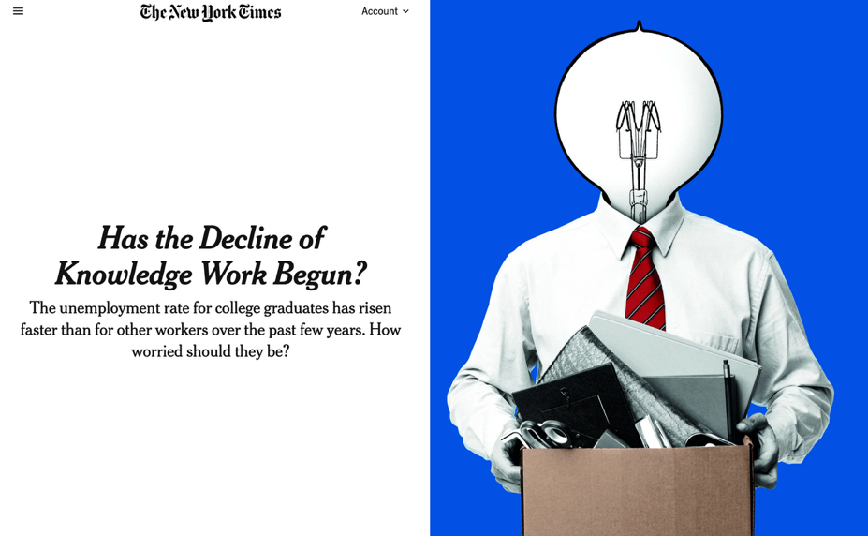
https://www.nytimes.com/2025/03/25/business/economy/white-collar-layoffs.html

Slide 32
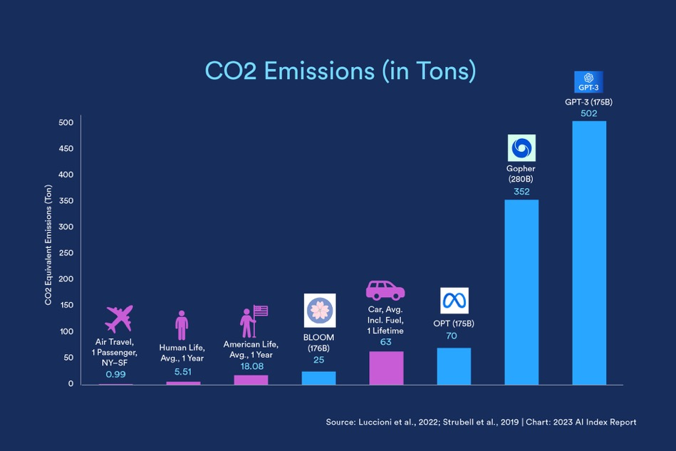

Slide 33
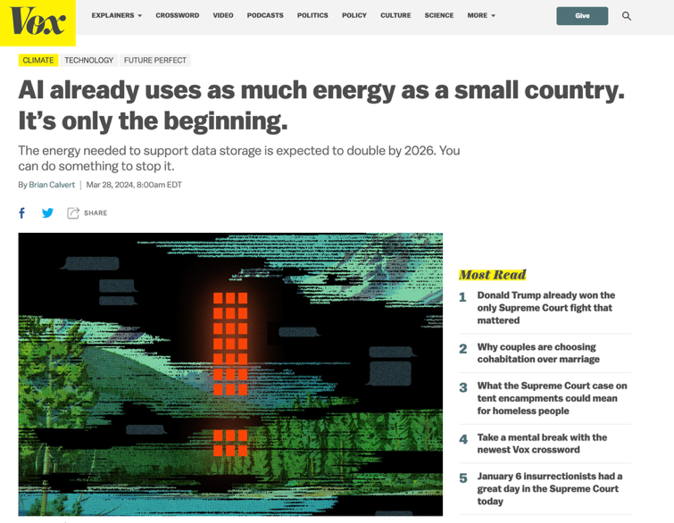
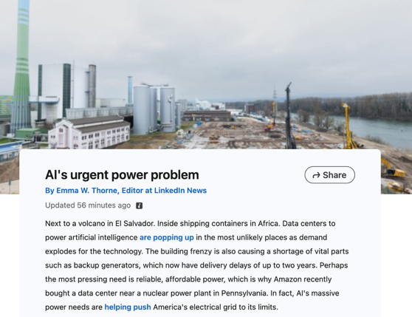

Slide 34
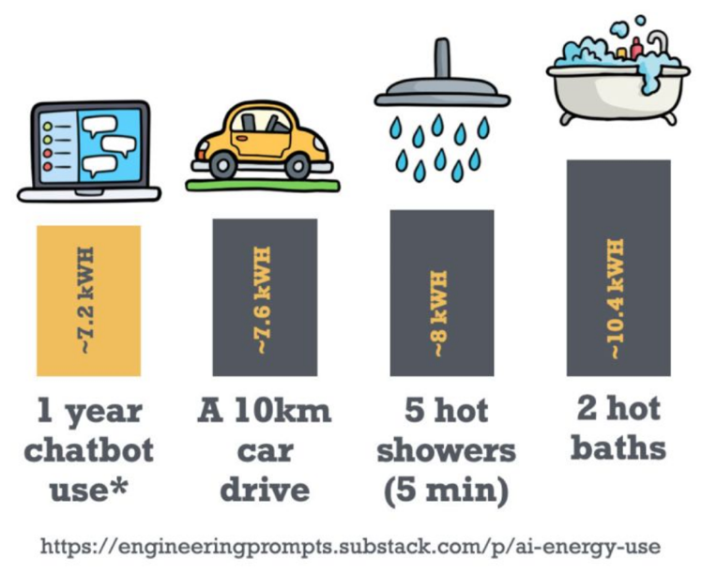

Slide 35
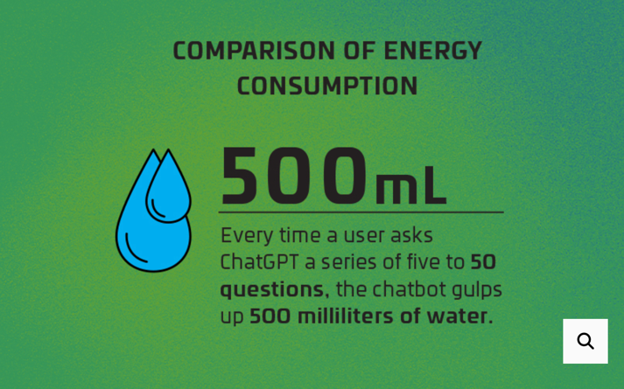

https://wired.me/science/energy/ai-vs-bitcoin-mining-energy
https://www.oregonlive.com

Slide 36
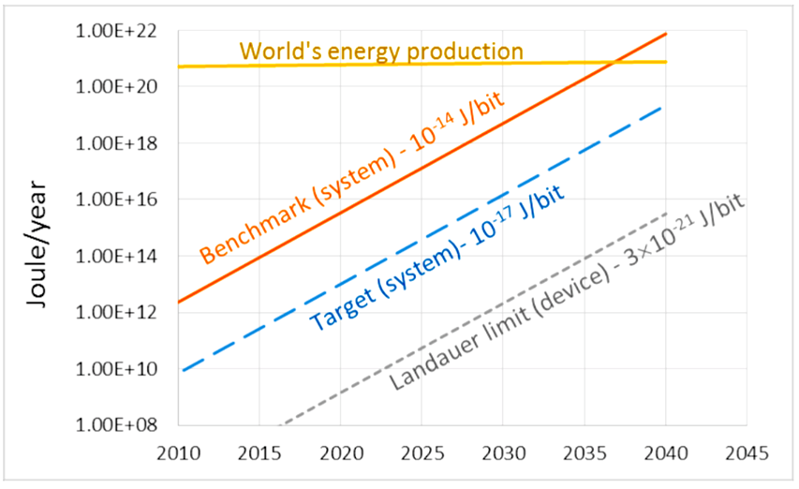
?
Estimated total energy expenditure for computing, directly related to the number of raw bit transitions. Source: SIA/SRC.

Slide 37
Progress in AI/ML is currently largely dependent
on advances in hardware
Thus this course.
Thus why this is a timely topic of interest to any computer engineer.

Slide 38
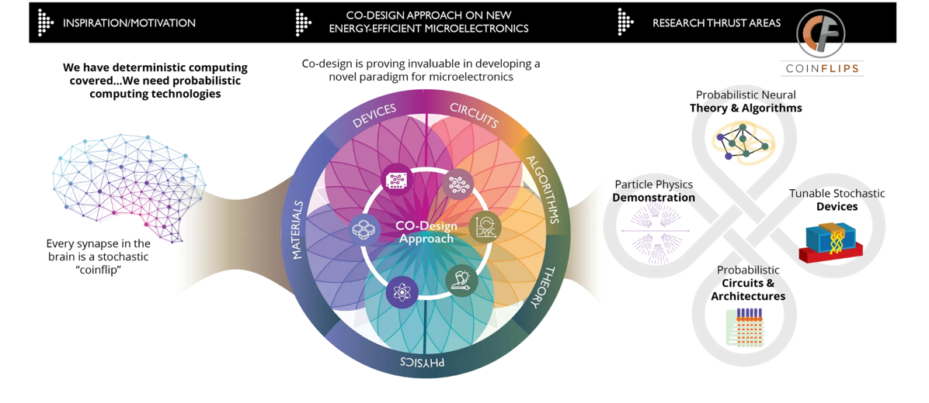

Co-design
https://coinflipscomputing.org

